Slide 1
Stock Price Analysis
Avik Kadakia and Atharva Kadam
ISE 487

Slide 2
Problem
We wanted to study the stock prices of several companies and try to predict the prices for the next x amount of time. We decided to study how the prices change over time and how are they affected by ongoing factors at that specific time.

Slide 3
Approach
We started by looking up different resources to study and understand how things change over time and they can be predicted. Upon researching a few resources and consulting with Professor Tripathi, we decided the best modal to use for the analysis is a time series model. As suggested by Professor Tripathi, we went forward to learn about the ARIMA model and how it could assist us in understanding the data further.

Slide 4
Stock Prices
We started by retrieving data for the following companies for as many years as we could from Yahoo! Finance:
Apple | Goldman Sachs
Amazon | Intel Corporation
Capital One Financial Corp. | Microsoft
Facebook | Netflix
Google | Tesla

Slide 5
Research
In order to start using ARIMA to help us predict. We needed to first learn what is ARIMA? Therefore we started looking up articles on ARIMA and came across Jason Brownlee, PhD.

Slide 6
Jason Brownlee, PhD.
Machine Learning practitioner and professional developer
Masters and PhD. in Artificial Intelligence
Worked on Machine Learning for startups, defense, and severe weather forecasting
Handles the website: https://machinelearningmastery.com

Slide 7
Reference
When we came across Jason Brownlee’s sample code of ARIMA, we decided to learn from it by duplicating it and trying to achieve the same results. We started by reading his webpage and doing research about the different terms associated with ARIMA and how they all help you predict the best possible results. Later, we were able to duplicate his results and then we moved forward to trying to make it better.
Notes:
https://machinelearningmastery.com/arima-for-time-series-forecasting-with-python/

Slide 8
ARIMA
AutoRegressive Integrated Moving Average
A popular and widely used statistical method for time series forecasting is the ARIMA model
Provides a simple yet powerful method for making time series forecasts
AR: Autoregression: A model that uses the dependent relationship between an observation and some number of lagged observations.
I: Integrated: The use of differencing of raw observations (e.g. subtracting an observation from an observation at the previous time step) in order to make the time series stationary.
MA: Moving Average: A model that uses the dependency between an observation and a residual error from a moving average model applied to lagged observations
Notes:
https://machinelearningmastery.com/arima-for-time-series-forecasting-with-python/

Slide 9
Definitions
Stationarity: A stationary time series is one whose properties do not depend on the time at which the series is observed
Seasonality: Seasonal Variance. A trend that is observed based on a certain event occurring at a given time. For example, sales increasing around holidays.
Trend: Upward & downward movement of the data with time over a large period of time
Spikes: Spikes & troughs at random intervals
Notes:
https://towardsdatascience.com/machine-learning-part-19-time-series-and-autoregressive-integrated-moving-average-model-arima-c1005347b0d7
https://otexts.com/fpp2/stationarity.html

Slide 10
Types of Models
AutoRegressive Model (AR)
Moving Average (MA)
AutoRegressive Moving Average (ARMA)
AutoRegressive Integrated Moving Average (ARIMA)
Notes:
https://towardsdatascience.com/machine-learning-part-19-time-series-and-autoregressive-integrated-moving-average-model-arima-c1005347b0d7
https://otexts.com/fpp2/stationarity.html

Slide 11
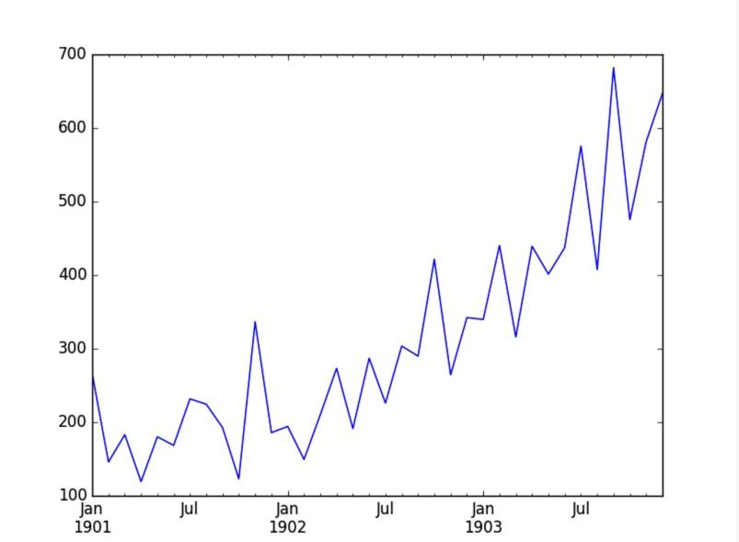
Shampoo Sales Dataset
Consisted of monthly shampoo sales for a 3 year period:

Slide 12
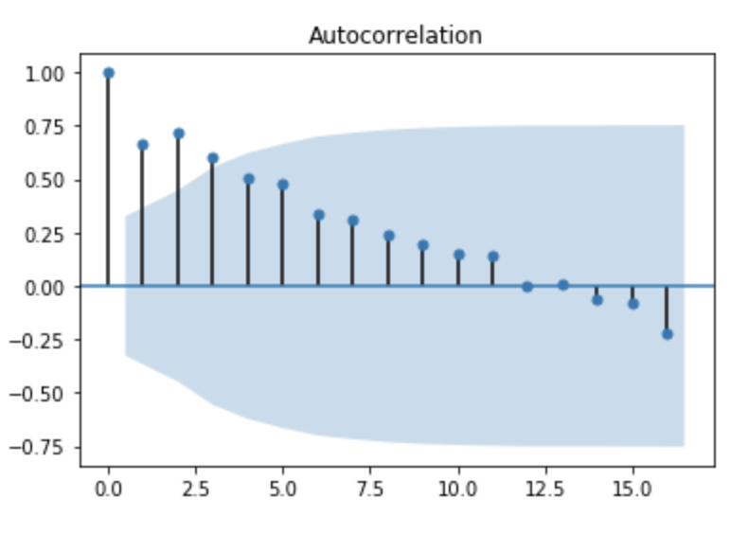
AutoCorrelation Plot
As we can see from the plot, it is not stationary. This means that we need to find the autocorrelation plot.
Definition: The correlation between the observations at the current point in time and observations at all previous points in time.
Based on the autocorrelation plot made using the AutoCorrelation Function (ACF), we can determine the the optimal number in terms of Moving Average.
Used to determine the need for the Moving Average Model.
Notes:
https://towardsdatascience.com/machine-learning-part-19-time-series-and-autoregressive-integrated-moving-average-model-arima-c1005347b0d7

Slide 13
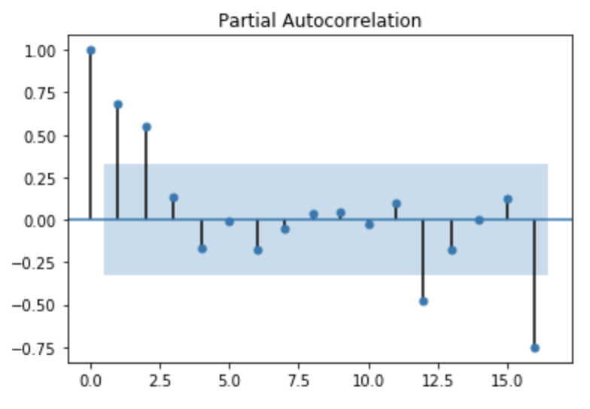
Partial AutoCorrelation Plot
Definition: The correlation between the observations made at two points in time while accounting for any influence from other data points
Based on the partial autocorrelation plot made using the Partial AutoCorrelation Function (PACF), we can determine the the optimal number in terms of AutoRegression.
Used to determine the need for the AutoRegressive Model.
Notes:
https://towardsdatascience.com/machine-learning-part-19-time-series-and-autoregressive-integrated-moving-average-model-arima-c1005347b0d7

Slide 14
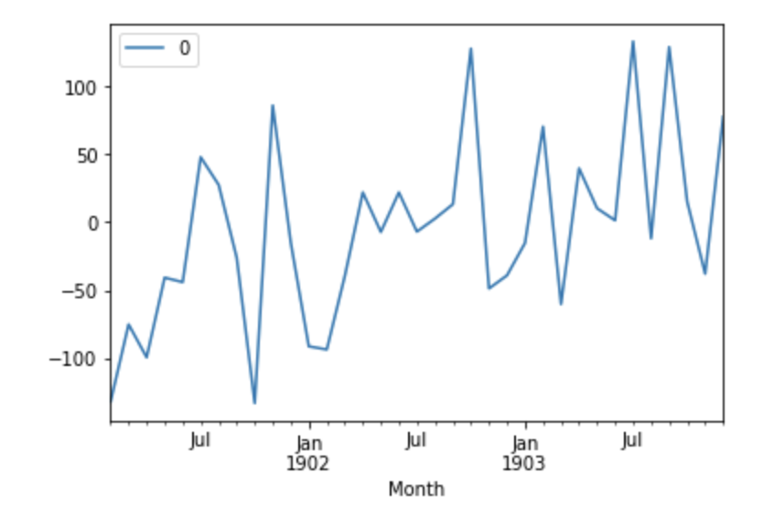
ARIMA Fit Residual Error Line Plot
Here is a line plot of the residual errors:
This suggests that there still may be some trend information that was not captured by the model

Slide 15
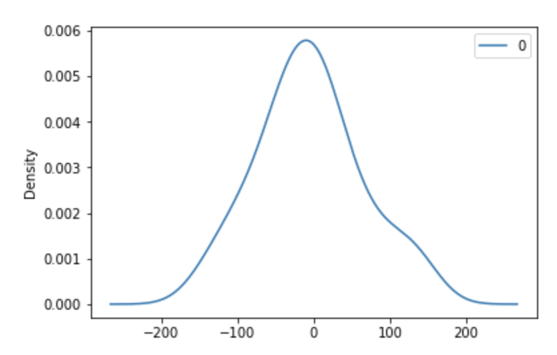
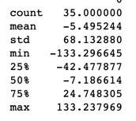
ARIMA Fit Residual Error Density Plot
This is a distribution of the residual errors that are displayed:
This means that there is a bias in the prediction (non-zero mean in residuals):

Slide 16
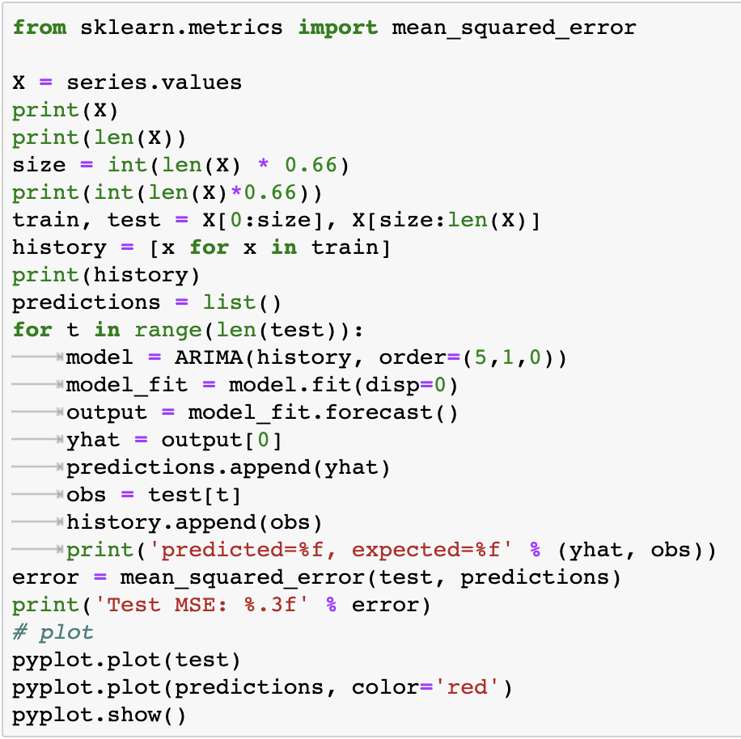
Rolling forecast with ARIMA

Slide 17
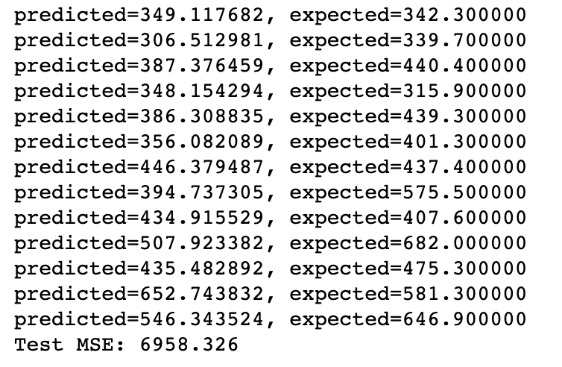
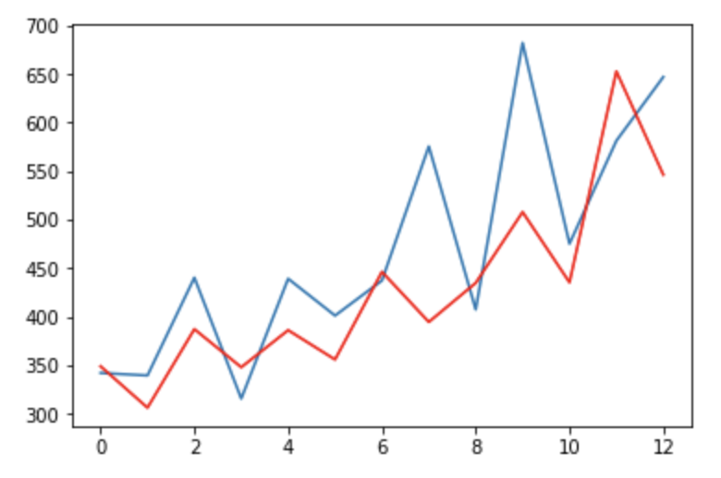
Results of ARIMA

Slide 18
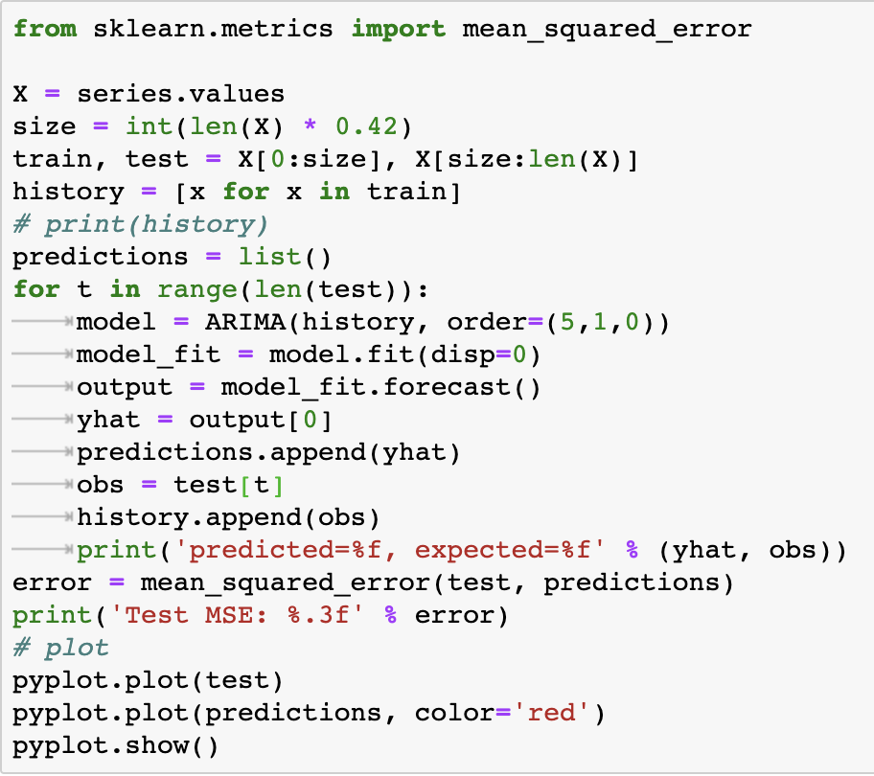
Rolling forecast with ARIMA - Optimized?

Slide 19
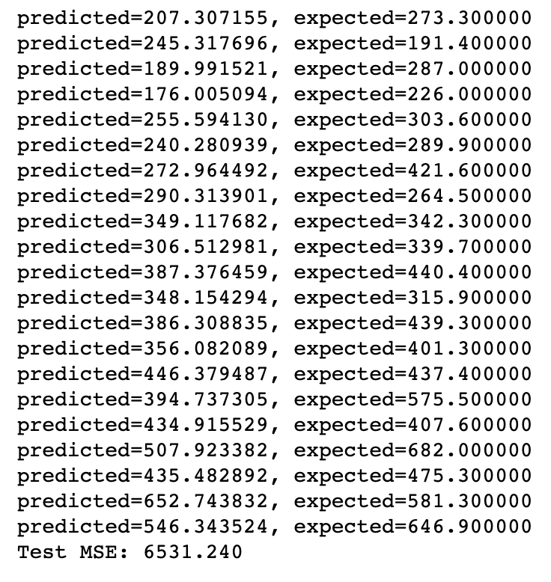
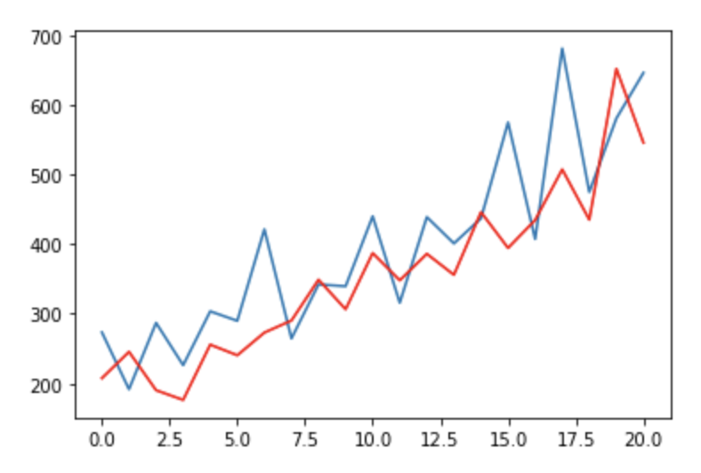
Results of ARIMA - Optimized ?

Slide 20
Inference
In order to optimize the original code provided by Dr. Brownlee, we started playing with the values that he was using. The major changes we made were to play around with the p, d, and q values but that did not get us anywhere.
Then we started playing with the training and testing set sizes. To our surprize, we got better results when we decreased the train set size from 66% to 42%. Upon doing this, we saw that the MSE dropped by 6.14%. The original MSE was 6958.326 and the new MSE turned out to be 6531.240.

Slide 21
Prediction Difference
Old
New

Slide 22
MSE Difference
Old
New

Slide 23
Problems
Made progress by 6.14% but only on 42% of the data as the train data.
Too expensive to run ARIMA at every iteration.

Slide 24
New Options
We started exploring new options to see how the ARIMA model can be used with a different algorithm to make the current algorithm more efficient. While exploring different resources and learning about the different implementations, we found the works of Cory Maklin, a data engineer at Interset.
Notes:
https://towardsdatascience.com/machine-learning-part-19-time-series-and-autoregressive-integrated-moving-average-model-arima-c1005347b0d7
https://towardsdatascience.com/@corymaklin

Slide 25
Procedure
Rolling Mean and Rolling Standard Deviation
Augmented Dickey-Fuller Test Statistics
Log of the dataset
Remove Seasonality (if any)
Subtracting rolling mean
Applying exponential decay
Subtract every point by the point preceding it
Running the ARIMA model
Predicting data
Notes:
https://towardsdatascience.com/machine-learning-part-19-time-series-and-autoregressive-integrated-moving-average-model-arima-c1005347b0d7

Slide 26
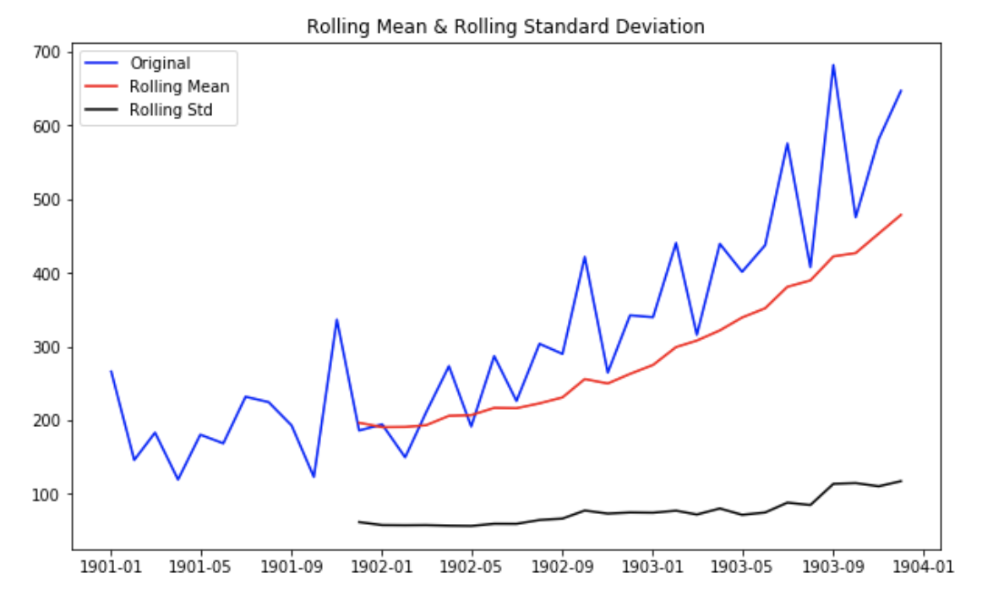
Rolling Mean and Rolling Standard Deviation
First we started by calculating the rolling mean and standard deviation of the data. If the rolling mean has an increasing slope, that means that there is seasonality in the data. As we can clearly see on the right, there was seasonality in the shampoo sales.
Notes:
https://towardsdatascience.com/machine-learning-part-19-time-series-and-autoregressive-integrated-moving-average-model-arima-c1005347b0d7

Slide 27
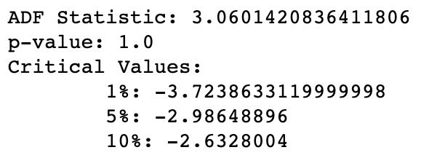
Augmented Dickey-Fuller Test
Another test that was conducted was the Augmented Dickey-Fuller Test. What this test did was provide us with an ADF statistic, the p-value and the critical values at 1%, 5%, and 10%.
If the ADF Statistic is far from the critical values and the p-value is greater than the threshold (0.05), which it is in our data originally, we can conclude that the time series is not stationary.
Notes:
https://towardsdatascience.com/machine-learning-part-19-time-series-and-autoregressive-integrated-moving-average-model-arima-c1005347b0d7

Slide 28
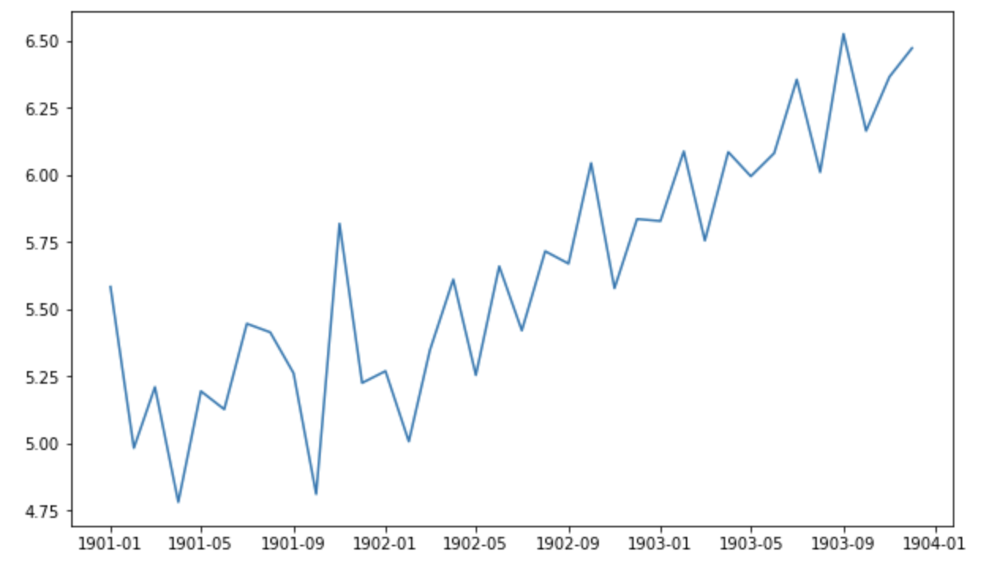
Natural Log of the Data
While researching on new methods to remove seasonality in the data, we read that taking the log of the entire data can greatly help “flatten” the graph and remove seasonality. Therefore, we decided to use the natural log of the data values. Once we had the log of the data, we started using other methods to help remove seasonality.
Notes:
https://towardsdatascience.com/machine-learning-part-19-time-series-and-autoregressive-integrated-moving-average-model-arima-c1005347b0d7

Slide 29
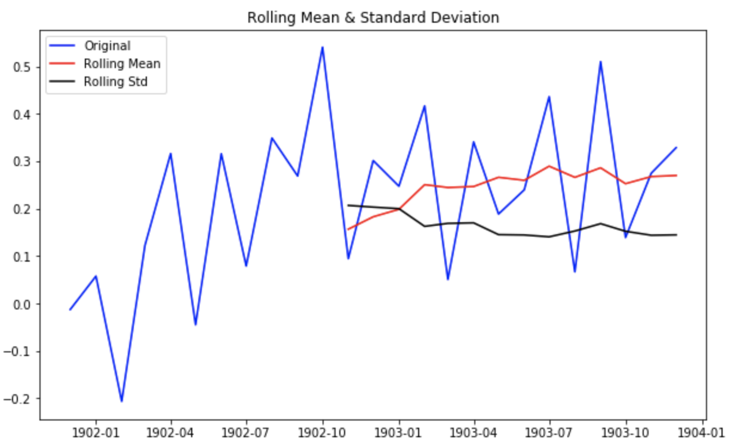
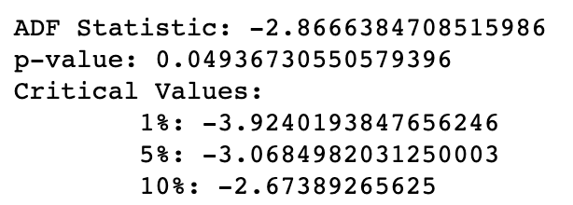
Subtracting Rolling Mean
Our first method was subtracting the rolling mean from the data. As you can see, we achieved some success but not exactly the amount we had hoped. So the search continued...
Notes:
https://towardsdatascience.com/machine-learning-part-19-time-series-and-autoregressive-integrated-moving-average-model-arima-c1005347b0d7

Slide 30
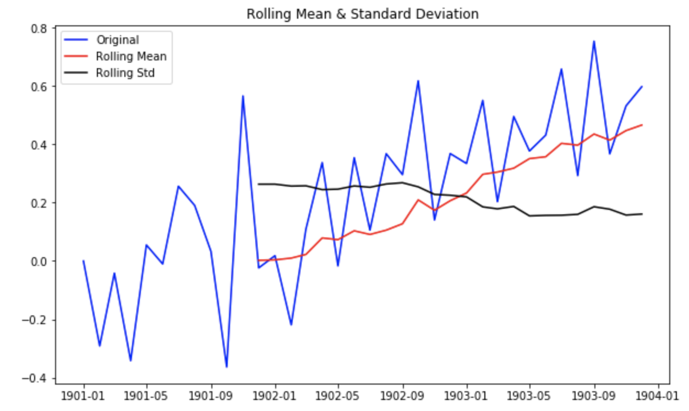
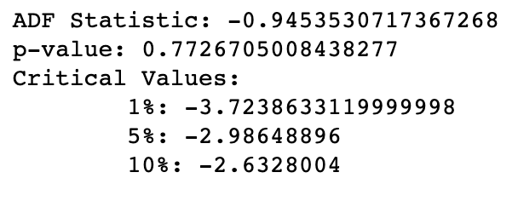
Exponential Decay
Our second method was subtracting the rolling mean from the data. As you can see, we are getting closer to the data we wanted but we weren’t there yet. And so our search continued...
Notes:
https://towardsdatascience.com/machine-learning-part-19-time-series-and-autoregressive-integrated-moving-average-model-arima-c1005347b0d7

Slide 31
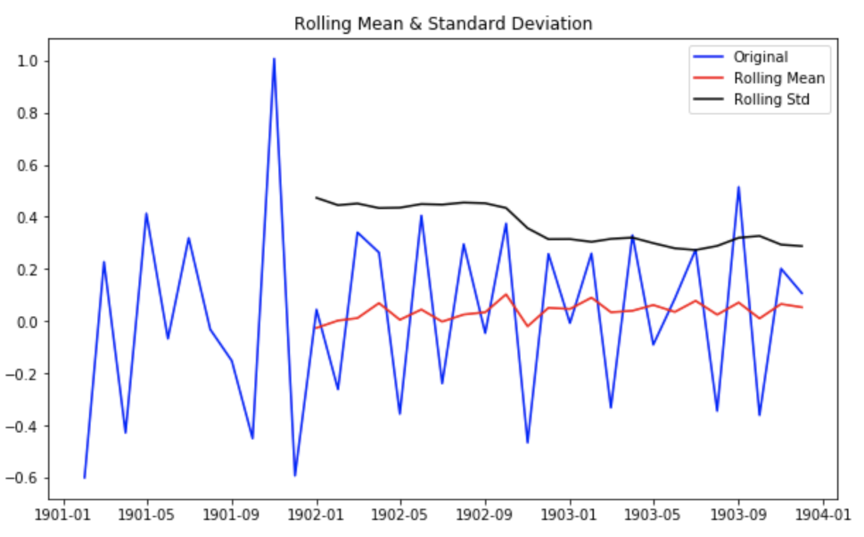
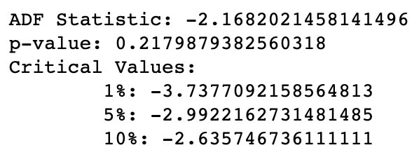
Subtracting from previous value
Our third method was subtracting the previous value from the current value to just work with the difference rather than the actual values. As you can see, this did not get us the best possible values but it did get us very far from where we started so we went forward using this method.
Notes:
https://towardsdatascience.com/machine-learning-part-19-time-series-and-autoregressive-integrated-moving-average-model-arima-c1005347b0d7

Slide 32
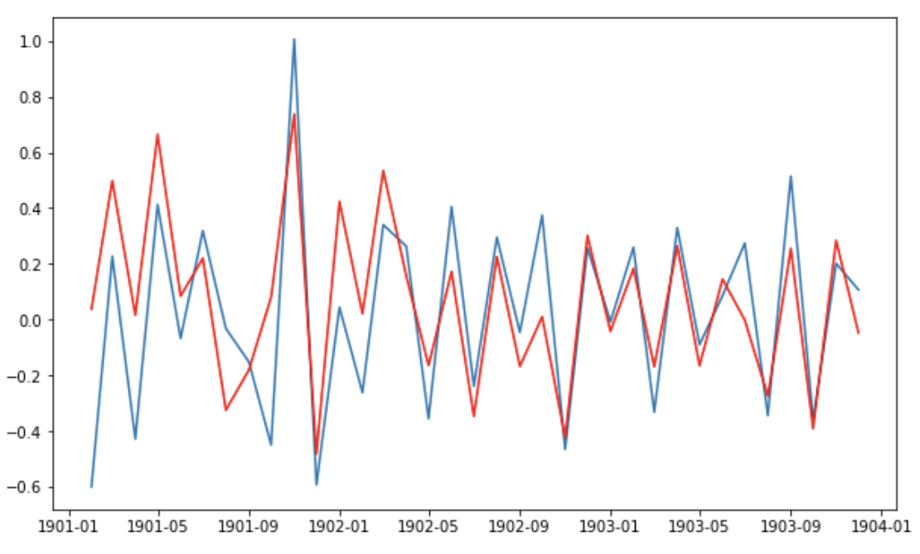
ARIMA Model

Slide 33
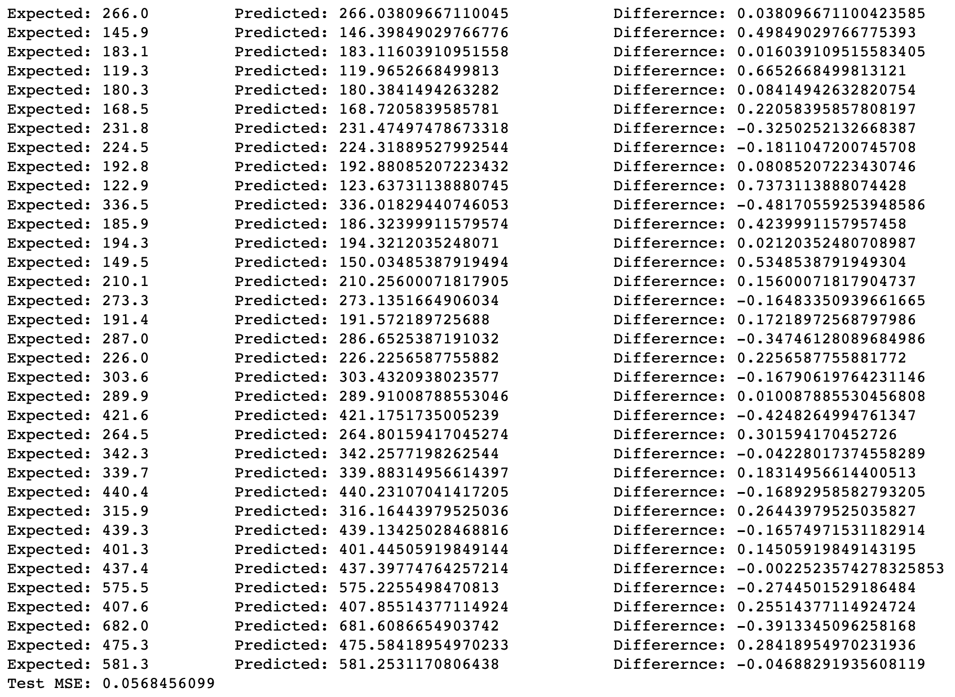

Slide 34
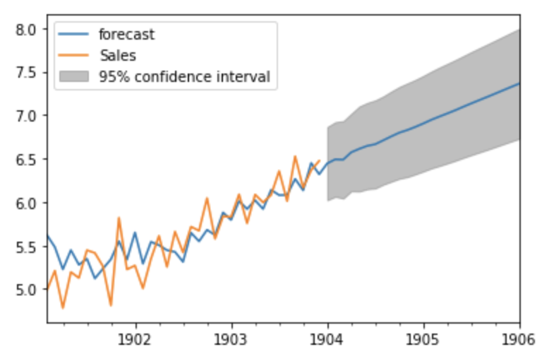
Prediction
Based on the predictions made for the test data and the MSE of 0.0568456099, we were tremendously happy about the success we had made. After exploring many more methods to help us with the prediction, we dropped the original MSE of 6958.326 to the new MSE of 0.0568456099. This was a 695832.599183% improvement than the method suggested by Dr. Brownlee. Hence with the newly trained data set, we went forward and predicted the data for the next 24 months.
Notes:
https://towardsdatascience.com/machine-learning-part-19-time-series-and-autoregressive-integrated-moving-average-model-arima-c1005347b0d7

Slide 35
What’s next?
Since we were able to learn so much and achieve such good results, the next thing that we will be doing is implementing ARIMA inthe same way to the stock data we have collected and try to predict the stop prices for the upcoming months.

Slide 36
The End

Slide 37
Bibliography
http://www.statsmodels.org/devel/generated/statsmodels.tsa.arima_model.ARIMAResults.html
https://otexts.com/fpp2/stationarity.html
https://www.statsmodels.org/stable/install.html
https://www.statsmodels.org/stable/generated/statsmodels.tsa.arima_model.ARIMAResults.forecast.html
https://machinelearningmastery.com/time-series-forecasting-methods-in-python-cheat-sheet/
https://byteacademy.co/blog/time-series-python
https://towardsdatascience.com/machine-learning-part-19-time-series-and-autoregressive-integrated-moving-average-model-arima-c1005347b0d7
https://machinelearningmastery.com/arima-for-time-series-forecasting-with-python/
https://towardsdatascience.com/@corymaklin

